Slide 1

Azure Service Bus Deep Dive
Sean Feldman
Azure MVP

Slide 2

Consulting Solutions Architect
Contributor to the FOSS ServiceBus Explorer tool
Worked on NServiceBus for Azure (Transport, hosting, persistence and Functions support)
Azure MVP

Slide 3

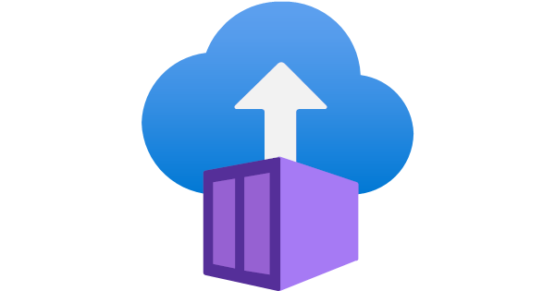






Notes:
What’s common between all these compute services?
They all benefit from messaging.

Slide 4





Azure Messaging Services
Events
Messages*
Event Grid
Event Hubs
Storage Queues
Service Bus
Cross-cloud
reactive events
Big data streaming
Simple task queues
Enterprise messaging
Notes:
Event
Lightweight notification of condition or state change
Discrete units or parts of a series (time ordered and interrelated)
Actionable, no coupling between publisher and subscriber
Message
Raw data produced by a sender
Expectations in form of a contract
Event Grid
Eventing backplane that enables event-driven reactive programming
Event consumption of Azure and Non-azure resources
The event message has the information you need to react to changes in services and applications
Event Grid isn't a data pipeline, and doesn't deliver the actual object that was updated.
Reactive programming, events are discrete facts
Event Hubs
Azure Event Hubs is a big data pipeline
For telemetry and event stream data (capture, retain and replay)
Low latency, capable of receiving and processing millions of events per second
Events are streamed in order
Azure Storage Queues
Introduced first, backed by Azure Storage
Allows to store large volumes of messages
Lightweight messages, simple durable task queues
64 KB messages
Azure Service Bus
Traditional enterprise applications that require rich messaging semantics
Reliable state transition management for business processes
Enables hybrid cloud solutions
Receive messages without polling
Richer application semantics like
FIFO
Deduplication
Transactional behavior and atomicity
Compliance with AMQP
Richer semantics like queues, topics and subscriptions, batching on send
communication backbone for many sophisticated cloud solutions

Slide 5

Tiers
Consumption
Provisioned
Basic
Standard
Premium
Notes:
Standard
Shared capacity
256 KB messages
Queues and Topics
$10 USD flat fee with 13 million free operations
Queues and Topics default 1 GB size (max 5 GB), with partitioning this can go to 80 GB with 16 partitions
Premium (recommended)
Dedicated capacity
1024 KB messages
Message operations unlimited
$677 USD per month
You can purchase 1, 2, 4 or 8 messaging units for each Service Bus Premium namespace. A single workload or entity can span multiple messaging units and the number of messaging units can be changed at will.
No partitioned queues and topics but 80 GB queues and topics

Slide 6

Broker and Client
.NET
NodeJS
Java
PHP
Python
Ruby

Slide 7



Slide 8
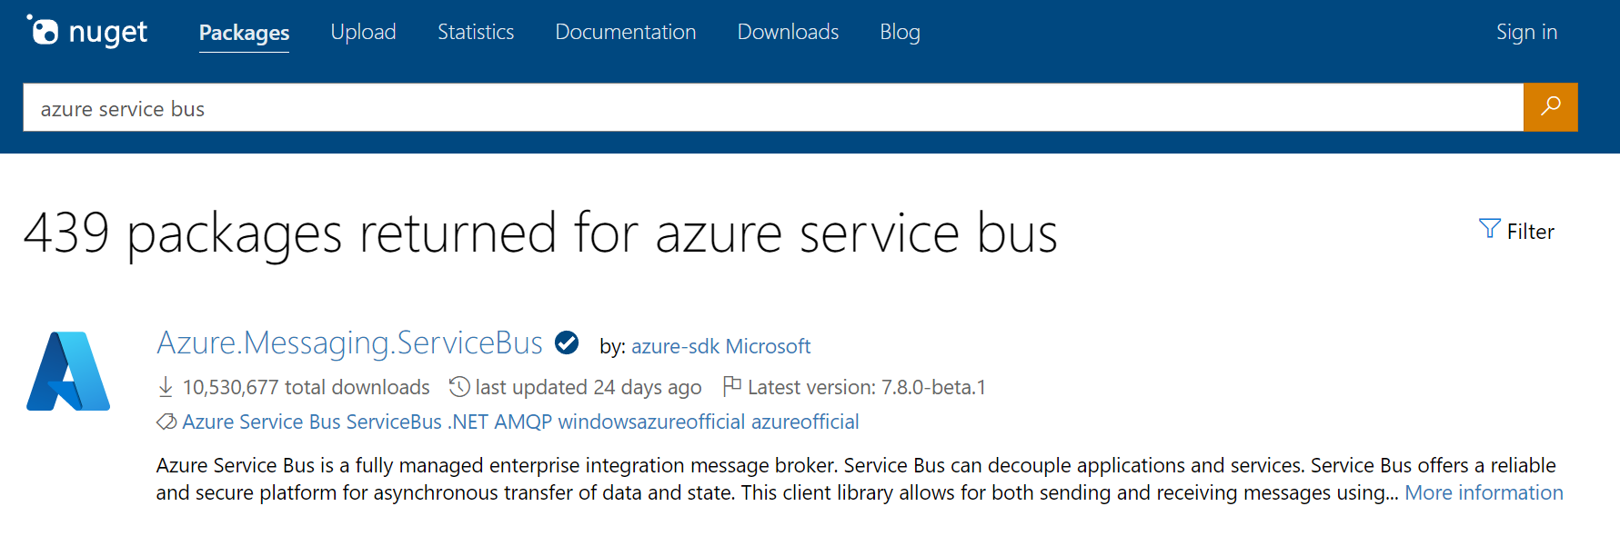
Notes:
Track 2 SDK (actually #3)

Slide 9
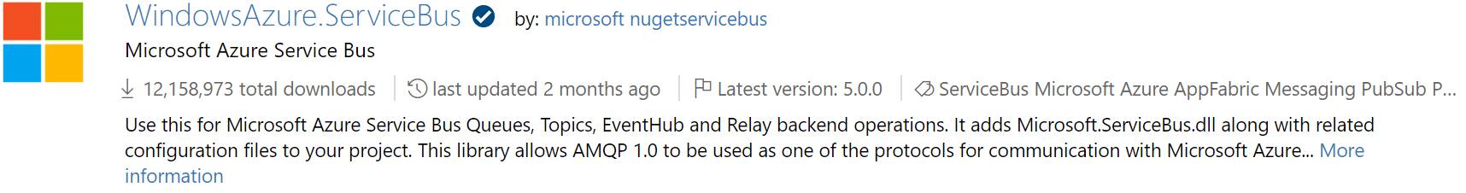
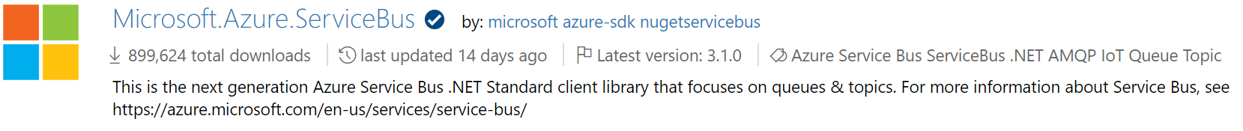
0
1

Slide 10



Slide 11

github.com/azure/azure-sdk-for-net
Notes:
A new mondo repo home

Slide 12

1.0
Notes:
AMQP + WebSockets
On the broker side, the new client is speaking AMQP 1.0 and no more SBMP protocol.
Meaning interoperability and less constraints (number of concurrent connections: 1K vs 5K)

Slide 13

Entity Management

Slide 14
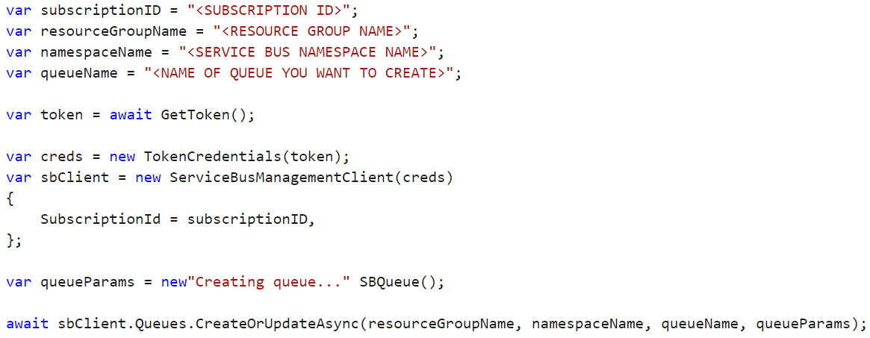
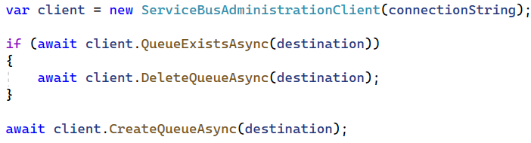
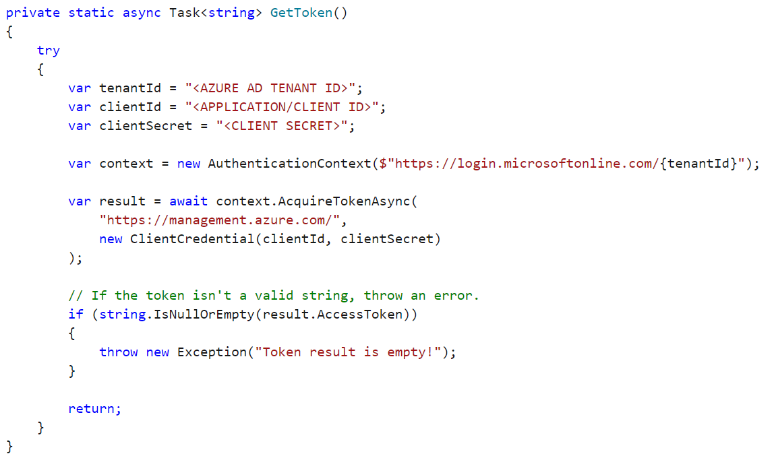
Management library
Microsoft.Azure.Management.ServiceBus
Client library
Azure.Messaging.ServiceBus

Slide 15
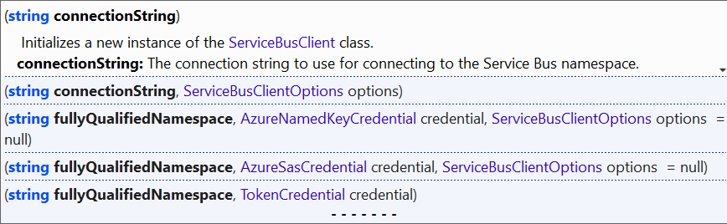
Connection Options

Slide 16

Sending Messages

Slide 17
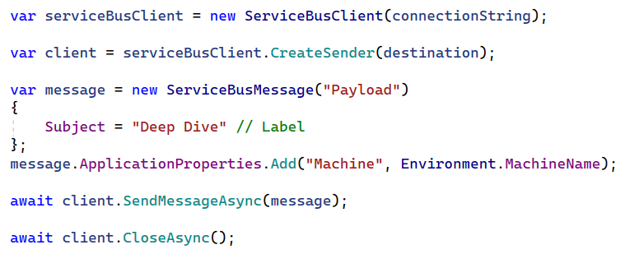
Code

Slide 18
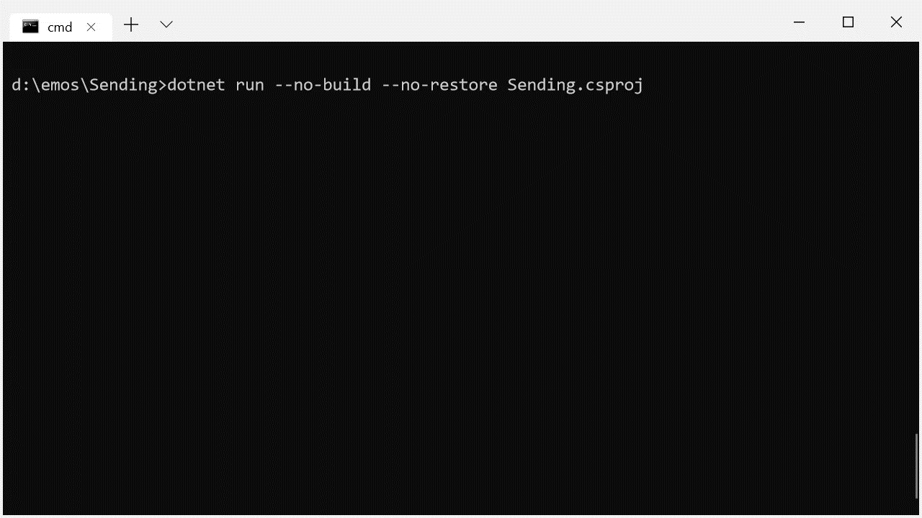

Slide 19
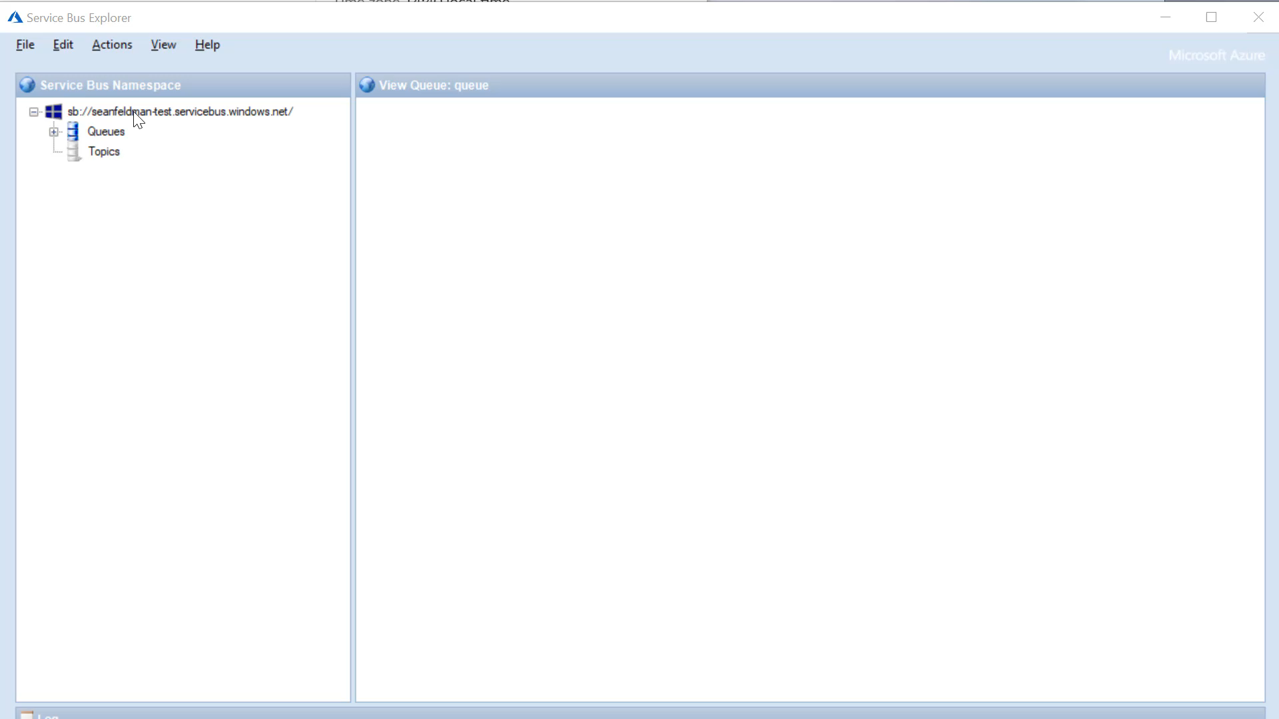

Slide 20

Receiving Messages

Slide 21
Receiving modes
ReceiveAndDelete
PeekLock
Notes:
Talk about PeekLock and ReceiveAndDelete

Slide 22
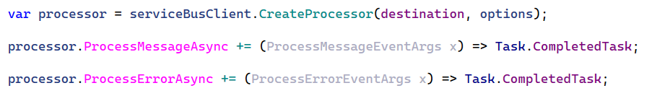
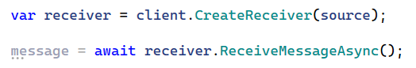
Simple Scenarios
ServiceBusProcessor
Advanced Scenarios
ServiceBusReceiver
Notes:
How do we receive? There are two options available
ServiceBusReceiver.ReceiveMessageAsync() requires to do manual heavy lifting such as concurrency etc. Also, hard to understand
Use message handlers instead
ServiceBusProcessorOptions
AutoCompleteMessages (defaults to true)
MaxConcurrentCalls (defaults to one)
MaxAutoLockRenewalDuration (defaults to 5mins)

Slide 23
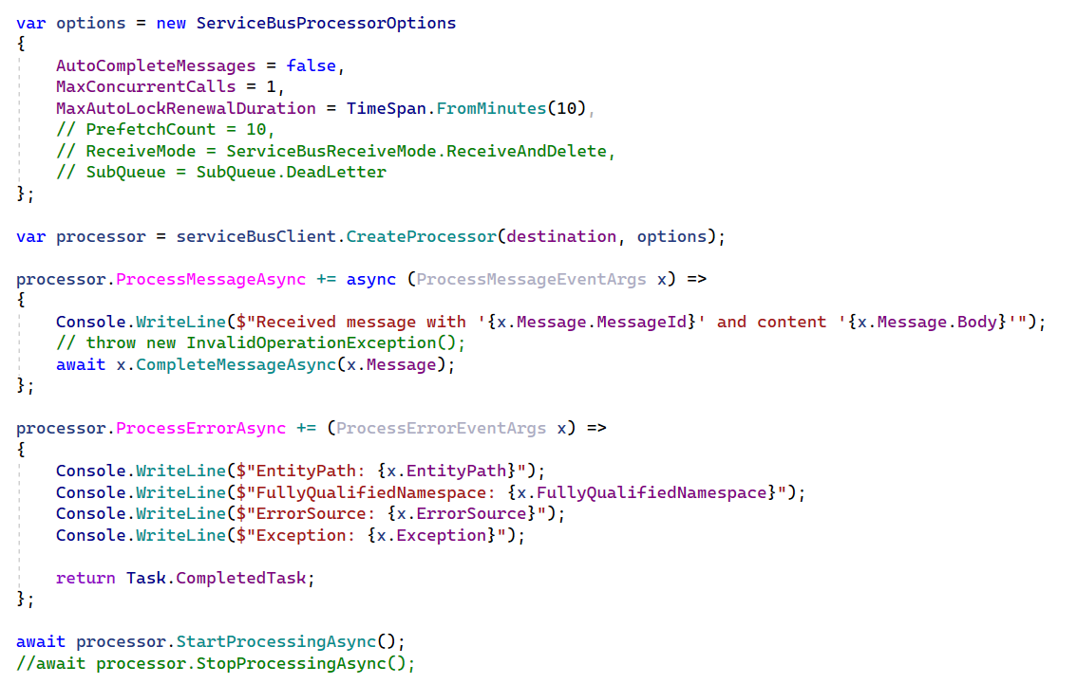
User Callback
Notes:
MessageHandlerOptions
Exception handler with ExceptionReceiveContext
AutoComplete (defaults to true)
MaxConcurrentCalls (defaults to one)
MaxAutoRenewDuration (defaults to 5mins)
What’s the right way? If you need to process incoming messages one by one and don’t want to build message pump logic, MessageHandler is a good option.
If batching is important, manual receive is a better option.

Slide 24
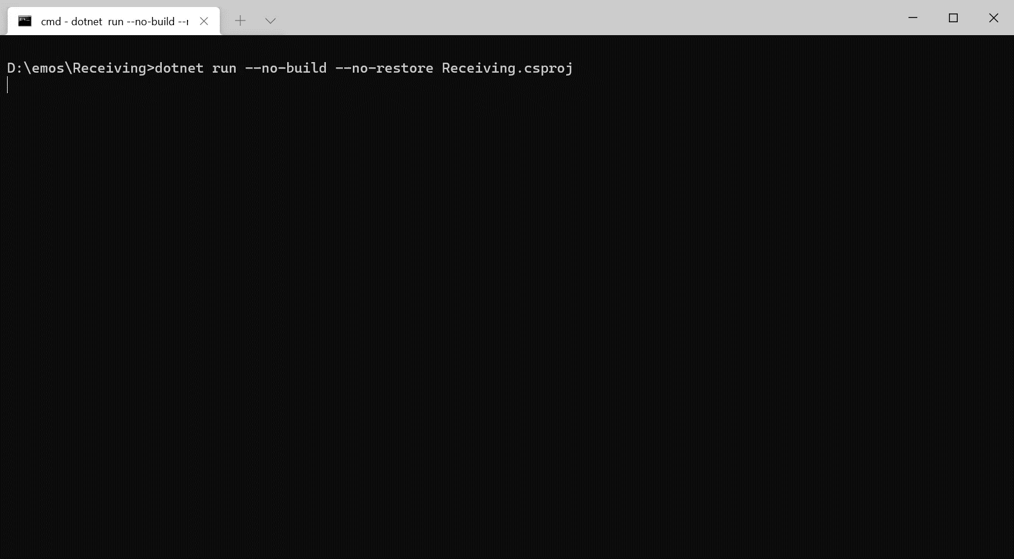

Slide 25


Slide 26
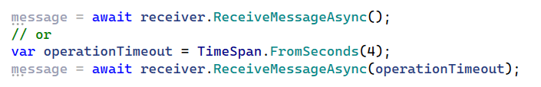
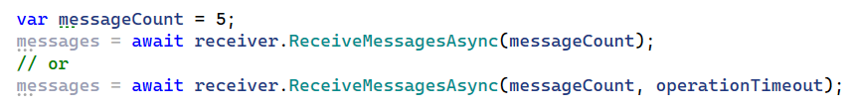
You’d think…
Notes:
// If there are 5 messages in the queue and 10 are requested, what will be the outcome?
// If there are 20 messages in the queue and 10 are requested, what will be the outcome?

Slide 27
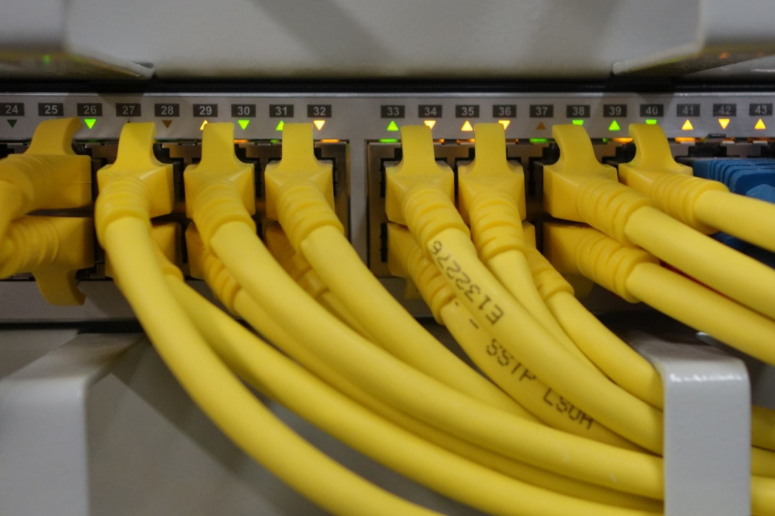
Connections Management

Slide 28
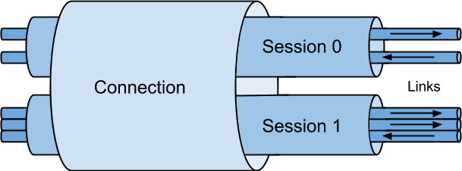
Connections and Connection Pooling
Notes:
No matter what way you’ll be connecting to the broker to send and receive messages, there’s something to keep in mind – connections

Slide 29
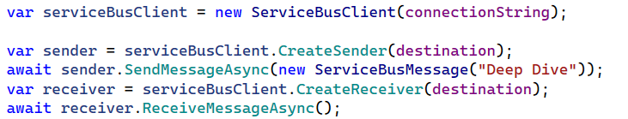
Shared Client

Slide 30
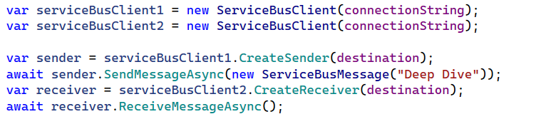
Multiple Clients

Slide 31
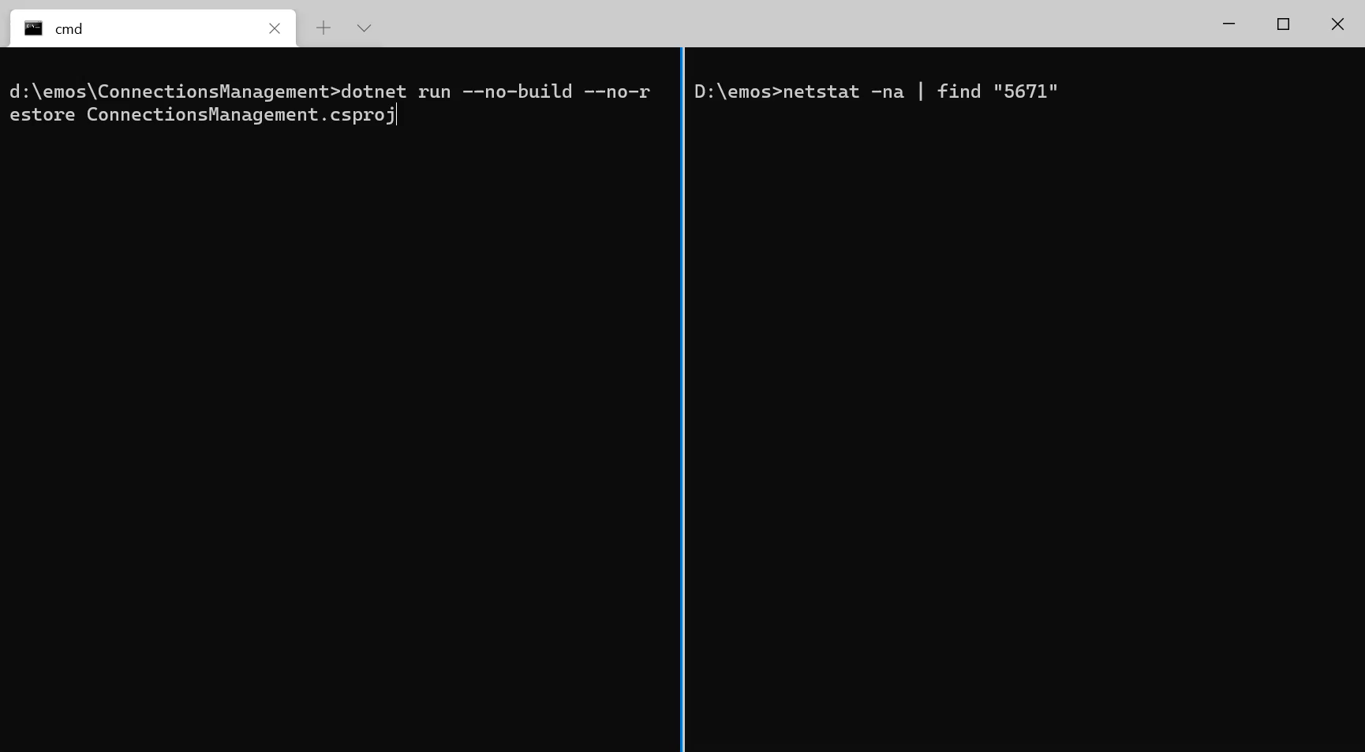

Slide 32

Recoverability (Retries)

Slide 33
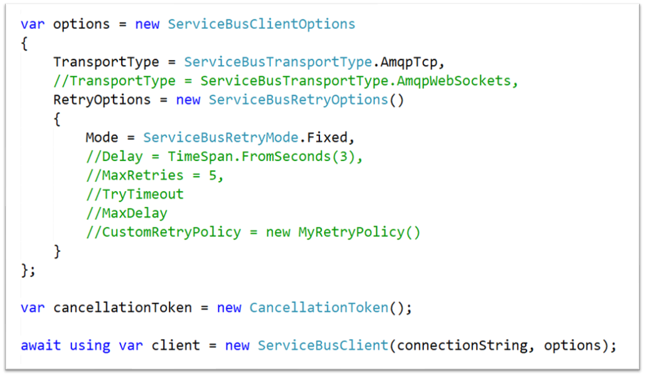
Notes:
Fixed vs Exponential

Slide 34

Message Scheduling
Notes:
WARNING! Messaging is not storage!
So when a message is scheduled, how can it be received earlier or cancelled?
To retrieve a specific message, SequenceNumber is required. But we got no sequence number until a message is received.
A bit of a chicken and an egg situation.
To solve this, we could peek for a message to find out its sequence number and retrieve it. Works for a single scheduled message, not when there are multiple ones…
That’s why scheduling using a client / message sender is a better option.

Slide 35
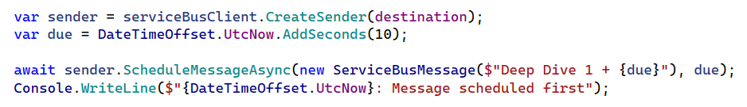
Schedule w/o a receipt

Slide 36
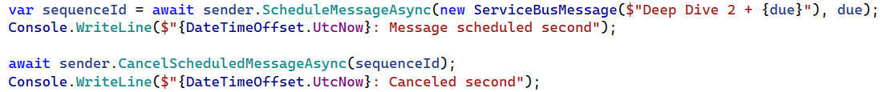
Schedule with a receipt

Slide 37
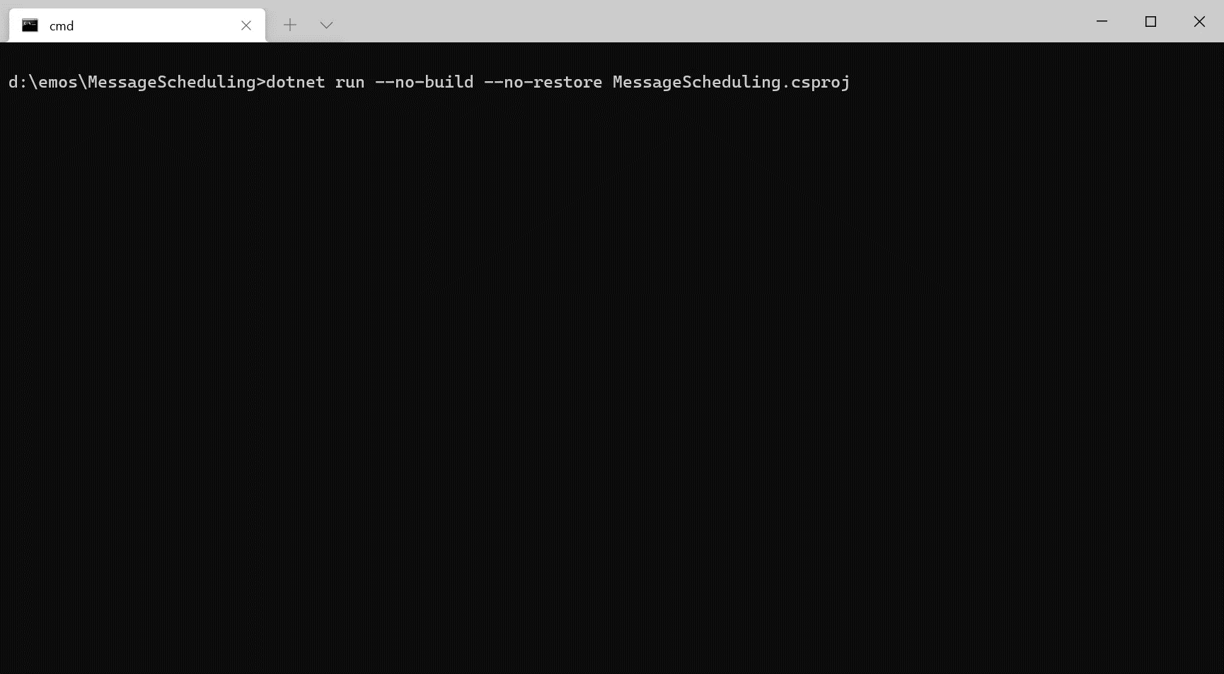

Slide 38

Message Expiration
Notes:
If messages need to be marked as short lived it is possible to give it a TimeToLive. TimeToLive can be set on the message or on the entity. Setting a longer TTL on the message than on the entity adjusts the TTL to the entity TTL.

Slide 39
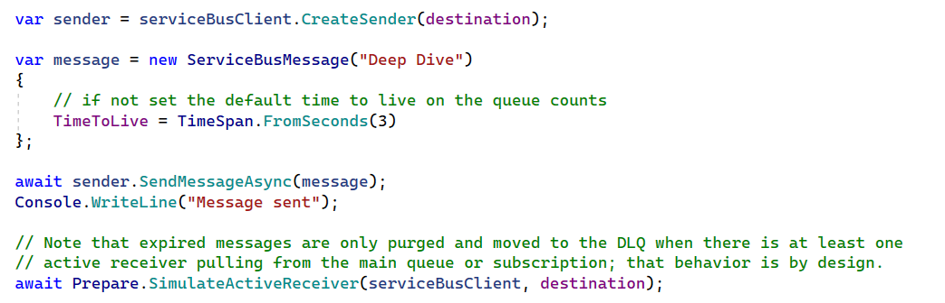
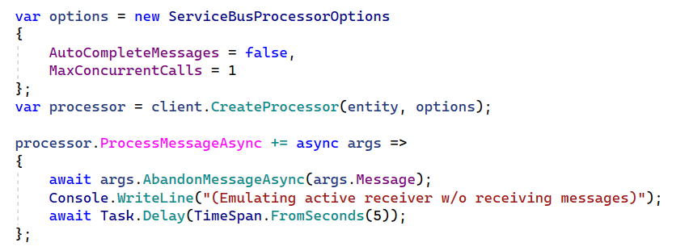
Notes:
Expired messages are only purged when there is at least one active receiver pulling from the main queue or subscription, that behavior is by design

Slide 40
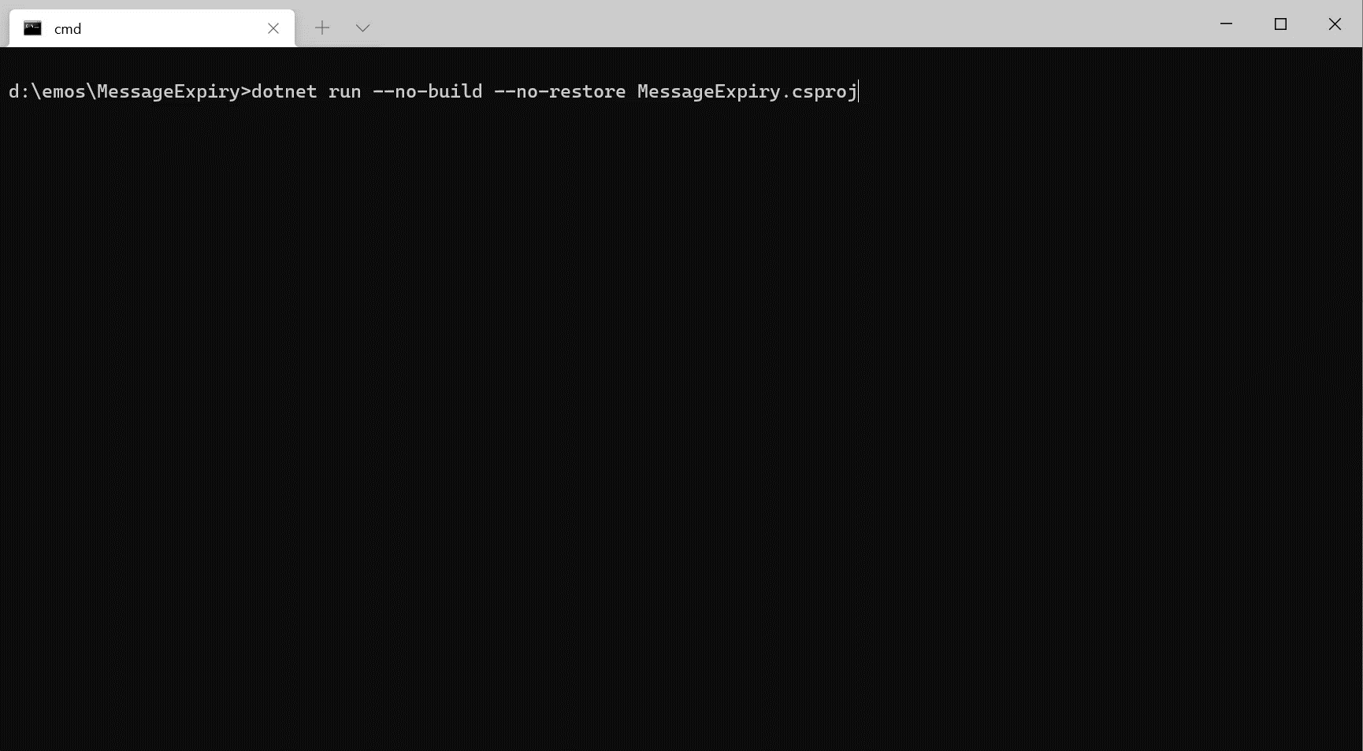

Slide 41

Message Forwarding
Notes:
Guaranteed broker-side operation
Max 4 hops
More than 4 hops – message is dead-lettered
Dead-lettered messages are stamped with Reason and Source
Cannot receive from auto-forwarding entity
Metrics to the rescue
Service Bus bills one operation for each forwarded message.

Slide 42
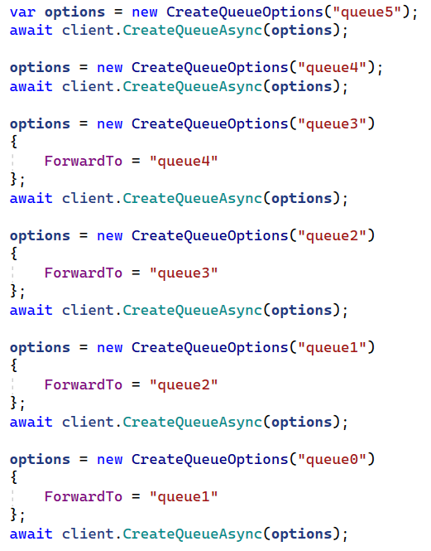
0
1
2
3
4

Slide 43
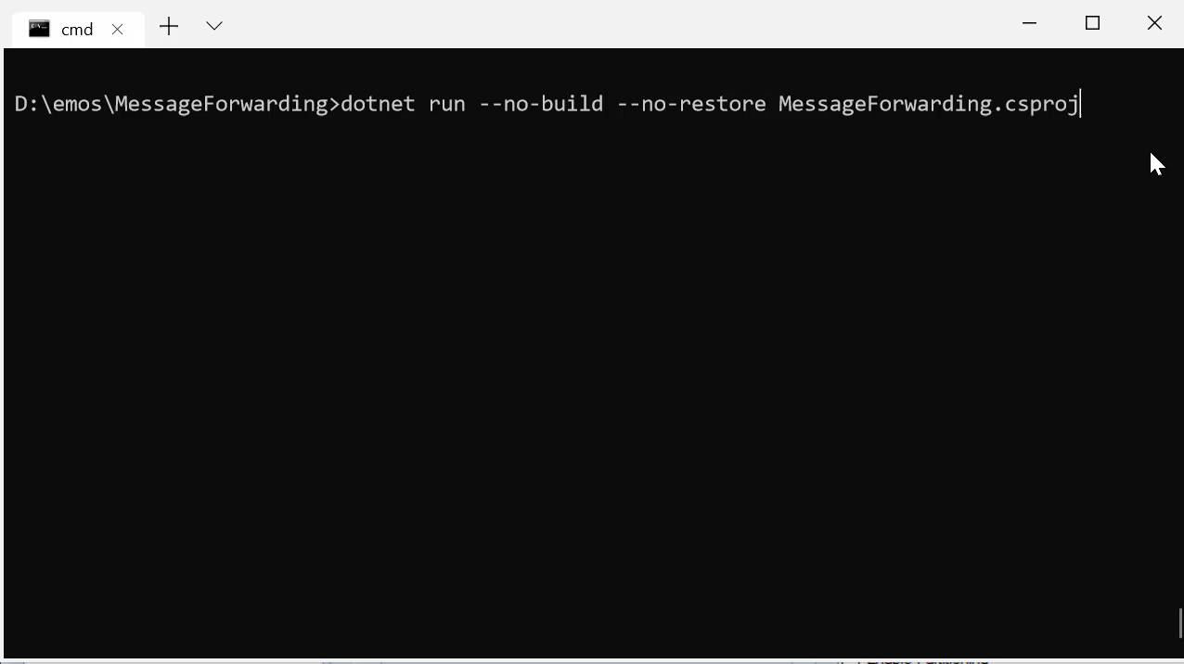

Slide 44
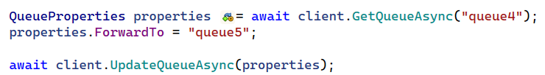
0
1
2
3
4
5

Slide 45
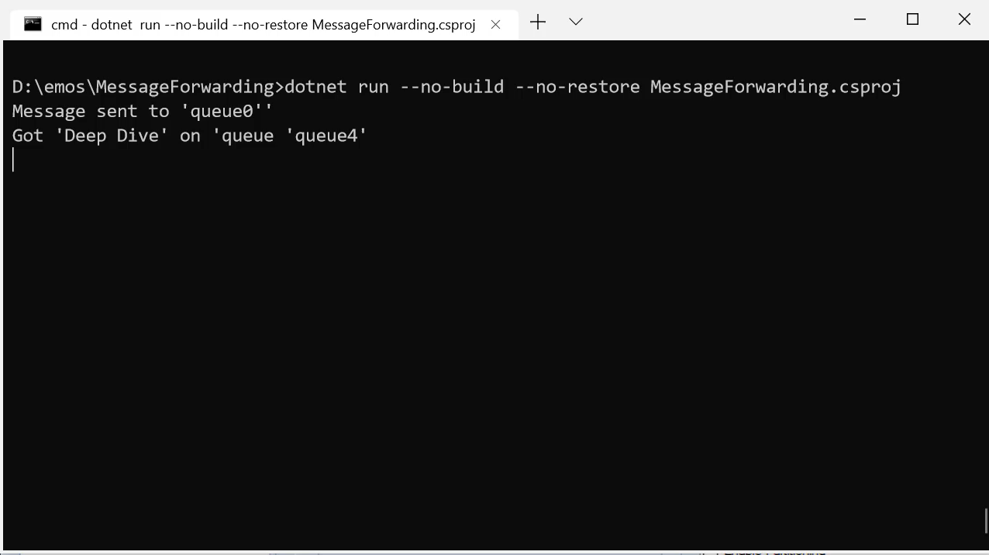

Slide 46

Message Dead-lettering
queue/$DeadLetterQueue
Notes:
Reasons for dead-lettering
Exceeded MaxDeliveryCount
Exceeded maximum number of hops (4) when forwarding messages
Exceeded TimeToLive when configured to dead-letter using EnableDeadLetteringOnMessageExpiration
Errors while processing subscription rules when SubscriptionDescription.EnableDeadLetteringOnFilterEvaluationExceptions is set
Send-Via scenario which we’ll talk about later
Every queue has essentially 4 queues
queue
queue/$DeadLetterQueue (For subscriptions, topic-name/Subscriptions/subscription-name/$DeadLetterQueue)
queue/$Transfer

Slide 47
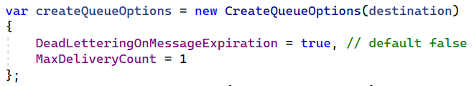
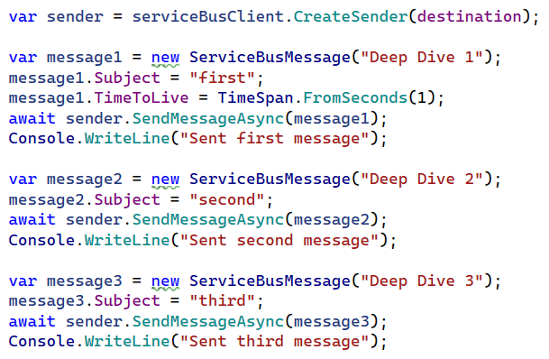
Setup

Slide 48
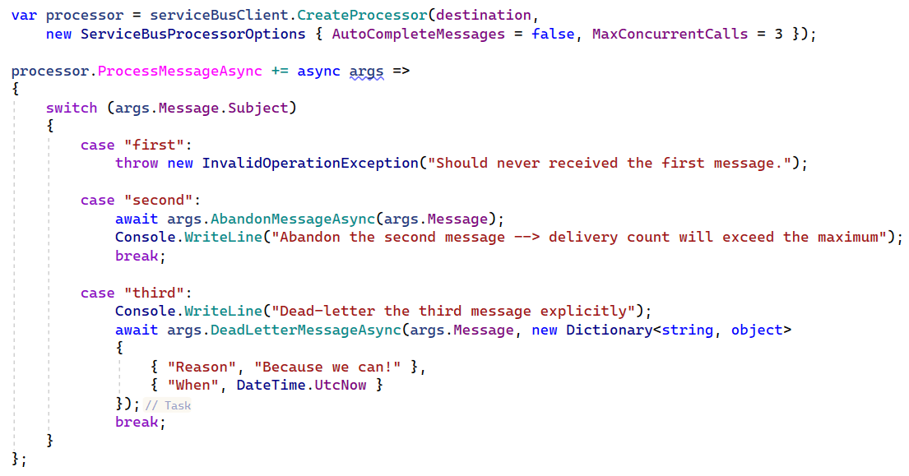
Message pump

Slide 49


Slide 50

Pub/Sub
Notes:
In contrast to queues, in which each message is processed by a single consumer, topics and subscriptions provide a one-to-many form of communication, in a publish/subscribe pattern. Useful for scaling to large numbers of recipients, each published message is made available to each subscription registered with the topic.
Senders only knows Topics
Receivers only know about Subscriptions
Subscriptions have Filters (rules) and Actions
Rules evaluated using OR logic

Slide 51

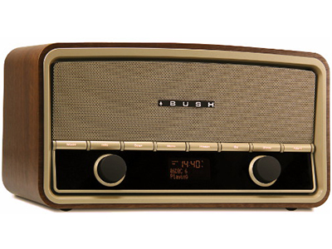

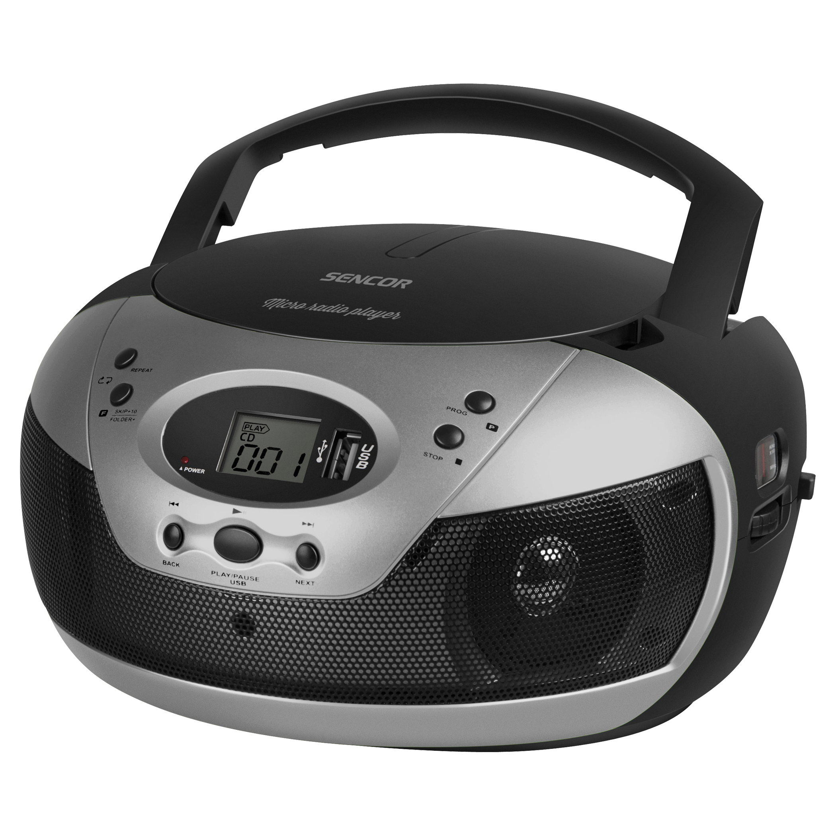
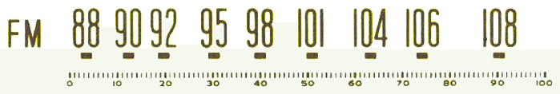
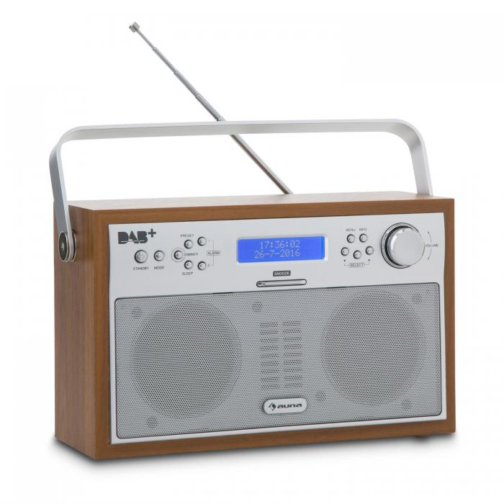
Publish/Subscribe
Senders only knows Topics
Receivers only know about Subscriptions
Subscriptions have Filters (rules) and Actions
Rules evaluated using OR logic
type=order
Rule
Subscription 1
“type” = “order”
type=quote
Topic
“type” = “quote”
Rule
Subscription 2
Notes:
Messages are sent to a topic and delivered to one or more associated subscriptions, depending on filter rules that can be set on a per-subscription basis. The subscriptions can use additional filters to restrict the messages that they want to receive. Messages are sent to a topic in the same way they are sent to a queue, but messages are not received from the topic directly. Instead, they are received from subscriptions. A topic subscription resembles a virtual queue that receives copies of the messages that are sent to the topic. Messages are received from a subscription identically to the way they are received from a queue.

Slide 52
Rule
Boolean
Filter
Filter
SQL
Filter
Correlation
Filter
Action
Notes:
Boolean filters - The TrueFilter and FalseFilter either cause all arriving messages (true) or none of the arriving messages (false) to be selected for the subscription.
SQL Filters - A SqlFilter holds a SQL-like conditional expression that is evaluated in the broker against the arriving messages' user-defined properties and system properties. All system properties must be prefixed with sys. in the conditional expression. The SQL-language subset for filter conditions tests for the existence of properties (EXISTS), as well as for null-values (IS NULL), logical NOT/AND/OR, relational operators, simple numeric arithmetic, and simple text pattern matching with LIKE.
Correlation Filters - A CorrelationFilter holds a set of conditions that are matched against one or more of an arriving message's user and system properties. A common use is to match against the CorrelationId property, but the application can also choose to match against ContentType, Label, MessageId, ReplyTo, ReplyToSessionId, SessionId, To, and any user-defined properties. A match exists when an arriving message's value for a property is equal to the value specified in the correlation filter. For string expressions, the comparison is case-sensitive. When specifying multiple match properties, the filter combines them as a logical AND condition, meaning for the filter to match, all conditions must match.
Actions: With SQL filter conditions, you can define an action that can annotate the message by adding, removing, or replacing properties and their values. The action uses a SQL-like expression that loosely leans on the SQL UPDATE statement syntax. The action is performed on the message after it has been matched and before the message is selected into the subscription. The changes to the message properties are private to the message copied into the subscription.

Slide 53
SQL vs Correlation Filters
Correlation is faster than SQL
No short-circuiting for SQL
Notes:
All filters evaluate message properties. Filters cannot evaluate the message body.
Complex filter rules require processing capacity. In particular, the use of SQL filter rules results in lower overall message throughput at the subscription, topic, and namespace level. Whenever possible, applications should choose correlation filters over SQL-like filters, since they are much more efficient in processing and therefore have less impact on throughput.

Slide 54
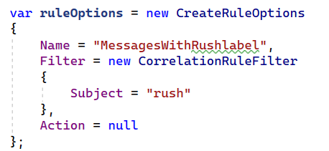
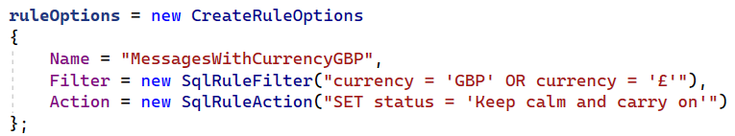
Setup

Slide 55
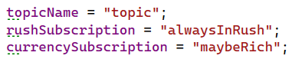
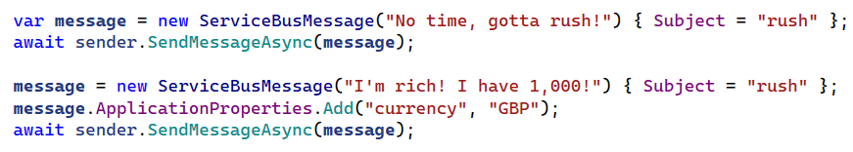
Invocation

Slide 56
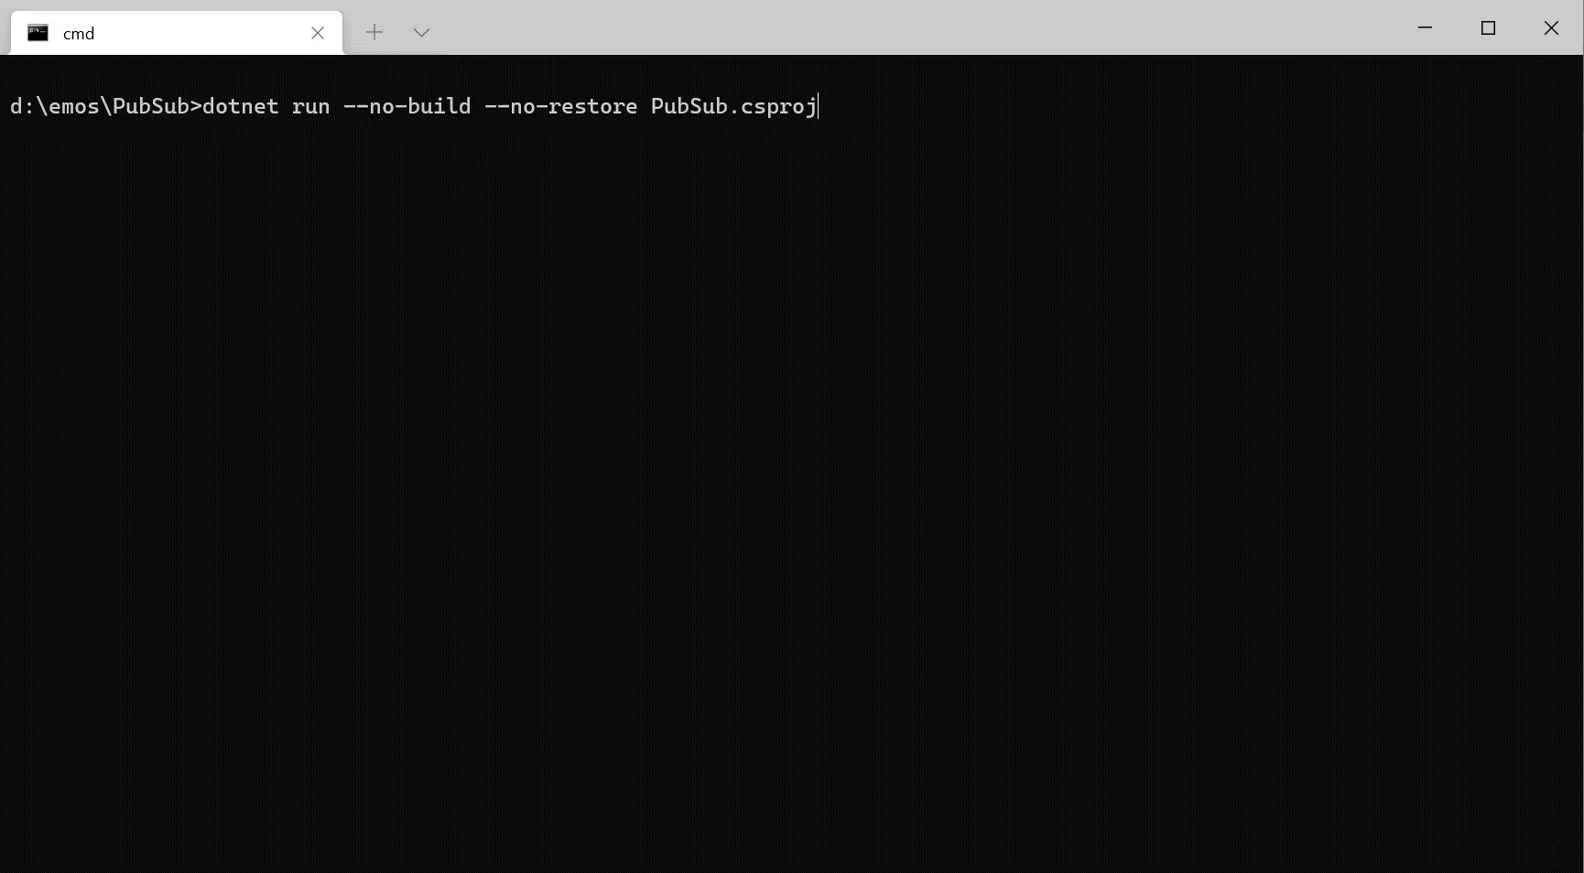

Slide 57

Message Batching

Slide 58
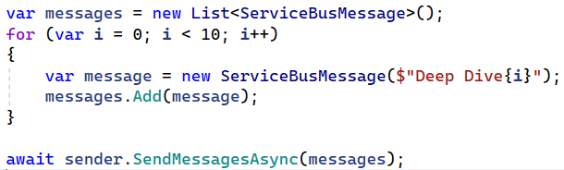
Sending a batch
Notes:
Total message size is the maximum batch size.

Slide 59
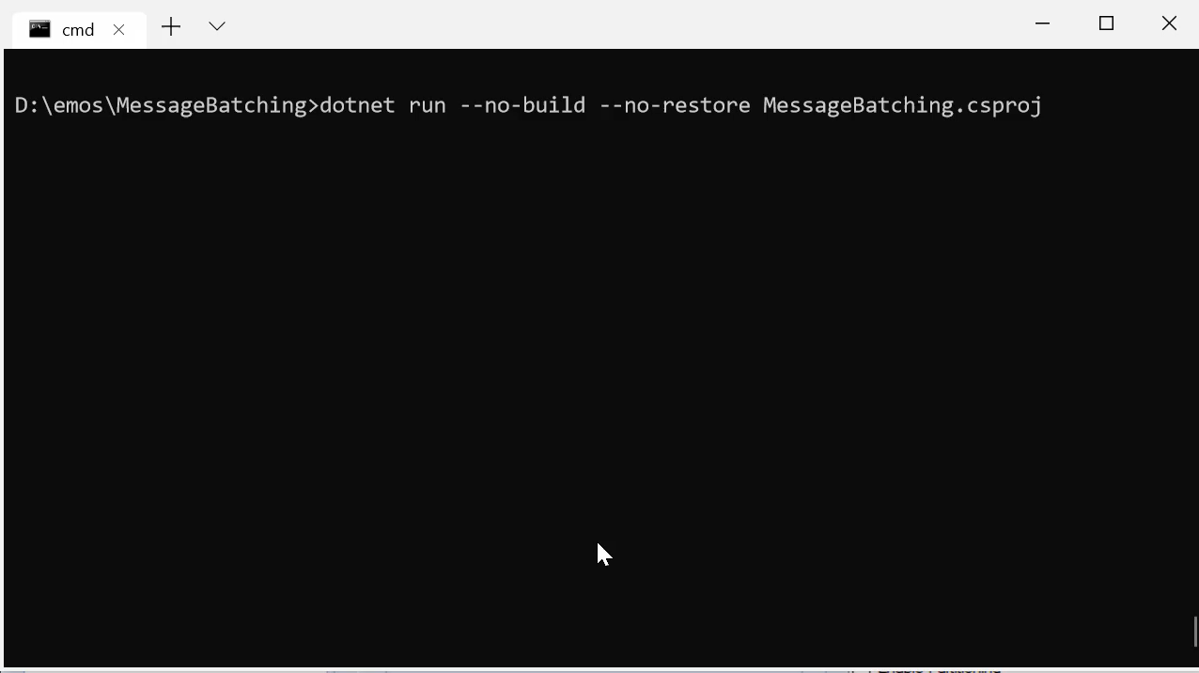

Slide 60
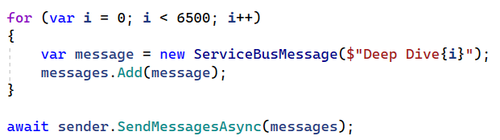
Sending a large batch
Notes:
Total message size is the maximum batch size.

Slide 61
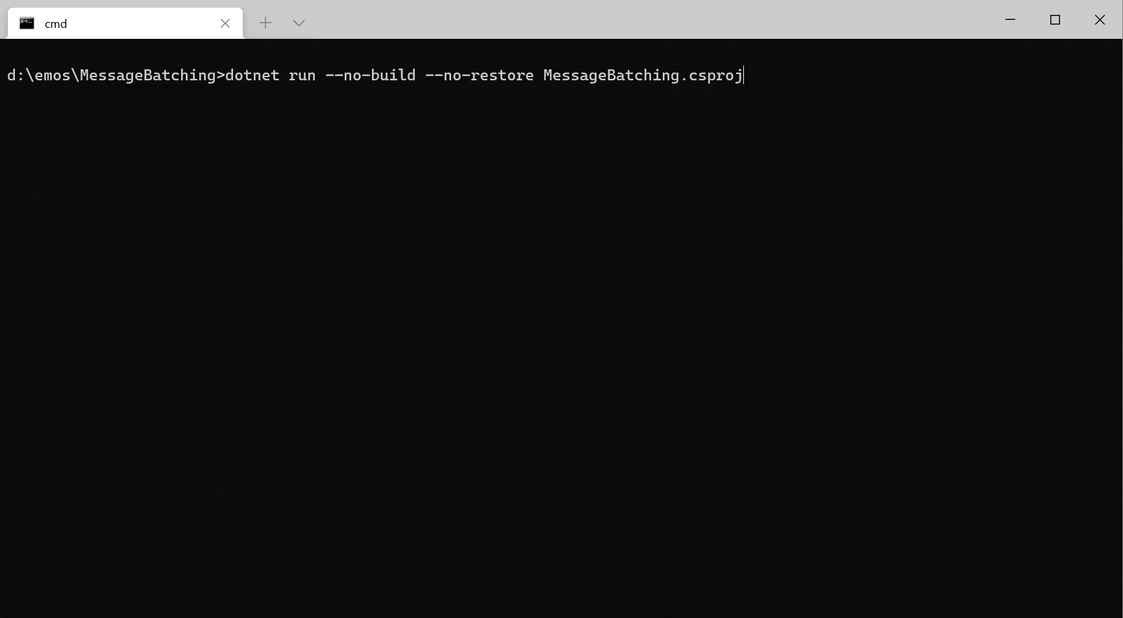

Slide 62
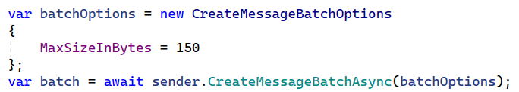

Safe batching

Slide 63


Slide 64

Messages larger than 256KB?
Upgrade to Premium Tier for messages up-to 100MB
ServiceBus.AttachmentPlugin
ServiceBus.CompressionPlugin

Slide 65

Atomic Sends
Notes:
Unlike a batch, we have a group of messages to send, but not all messages are available as at the same time.
We’d like to send messages in a transactional manner, ensuring that either all messages are sent successfully or they all rolled back

Slide 66

Individual sends

Slide 67


Slide 68

100 limit

Slide 69


Slide 70

Atomic sends with a batch

Slide 71


Slide 72

Cross-entity Transaction (Send Via)
Notes:
In scenarios where a transactional processing is required for an incoming message that would generate some outgoing messages, the incoming and outgoing messages should all succeed or rollback. Failure to do so would either create duplicate processing (failure to complete the incoming message) or ghost messages (failure to revert the outgoing messages).

Slide 73





A
Incoming
B
c
transfer
Notes:
Similar to shipping something from one point (source) to another point (destination), your package might go through straight to the destination and instead, might go through an intermediary.
The idea behind Send-via is to create an atomic operation between an incoming message and the outgoing messages.

Slide 74


Slide 75


Slide 76

When things go wrong

Slide 78

Transfer Dead-lettering
queue/$Transfer/$DeadLetterQueue
Notes:
Messages will be sent to the transfer dead-letter queue under the following conditions:
The destination queue or topic is disabled or deleted.
The destination queue or topic exceeds the maximum entity size.
Every queue has essentially 4 queues
queue
queue/$DeadLetterQueue
queue/$Transfer
queue/$Transfer/$DeadLetterQueue

Slide 79



Slide 80


Slide 81



Slide 82

Topologies

Slide 83
What’s a topology?
The way in which parts are interrelated or arranged
queue1
queue2
rules
topic
sub1
queue
sub2
rules

Slide 84



Slide 85


Slide 86

Message Sessions (FIFO)
Notes:
A session acts in many ways like a sub queue.
Sessions provide concurrent de-multiplexing of interleaved message streams while preserving and guaranteeing ordered delivery.

Slide 87

Notes:
When the MessageSession object is accepted and while it is held by a client, that client holds an exclusive lock on all messages with that session's SessionId that exist in the queue or subscription, and also on all messages with that SessionId that still arrive while the session is held.
The lock is released when Close or CloseAsync are called, or when the lock expires in cases in which the application is unable to perform the close operation. The session lock should be treated like an exclusive lock on a file, meaning that the application should close the session as soon as it no longer needs it and/or does not expect any further messages.
When multiple concurrent receivers pull from the queue, the messages belonging to a particular session are dispatched to the specific receiver that currently holds the lock for that session. With that operation, an interleaved message stream residing in one queue or subscription is cleanly de-multiplexed to different receivers and those receivers can also live on different client machines, since the lock management happens service-side, inside Service Bus.
The previous illustration shows three concurrent session receivers. One Session with SessionId = 4 has no active, owning client, which means that no messages are delivered from this specific session. A session acts in many ways like a sub queue.
The session lock held by the session receiver is an umbrella for the message locks used by the peek-lock settlement mode. A receiver cannot have two messages concurrently "in flight," but the messages must be processed in order. A new message can only be obtained when the prior message has been completed or dead-lettered. Abandoning a message causes the same message to be served again with the next receive operation.
Session state is - limited to the maximum message size

Slide 88



Slide 89



Slide 90


Slide 91
Session state
An opaque binary object that can hold data of the size of one message.
Session state remains as long as it is not cleared up (returning null), even if all messages in a session are consumed.

Slide 92

Message De-duplication

Slide 93



Slide 94


Slide 95

Extensibility
Plugins
Notes:
.NET client plugins
https://github.com/Azure/azure-sdk-for-net/blob/main/sdk/servicebus/Azure.Messaging.ServiceBus/MigrationGuide.md#plugins

Slide 96


Slide 97



Slide 98


Slide 99

BinaryData

Slide 100





Slide 101

Functions

Slide 102




Isolated Worker SDK
Microsoft.Azure.Functions.Work Microsoft.Azure.Functions.Worker.Extensions.ServiceBuser
In-Proc SDK
Microsoft.NET.Sdk.Functions Microsoft.Azure.WebJobs.Extensions.ServiceBus

Slide 103

Azure CLI
az servicebus --help
https://docs.microsoft.com/en-us/cli/azure/servicebus

Slide 104

Performance
Standard vs Premium

Slide 105
Standard Namespace Deployment
Compute Unit
Namespace A
Namespace B
Container A1
queue-a
queue-b
Container B1
queue-x
queue-y

Slide 106
Uneven Performance
Compute Unit
Compute Unit
Namespace A
Namespace B
Namespace A
Container A1
queue-a
queue-b
Container B1
queue-x
queue-y
Container A2
queue-c
queue-a: 20 msg/sec
queue-c: 200 msg/sec

Slide 107

Noisy Neighbour Effect
Compute Unit
Compute Unit
Namespace A
Namespace B
Namespace A
Container A1
queue-a
queue-b
Container B1
queue-x
queue-y
Container A2
queue-c
ServiceBusFailureReason.ServiceBusy: The request was terminated because the entity is being throttled. Please wait 10 seconds and try again

Slide 108
Credits System
Compute Unit
Compute Unit
Namespace A
Namespace B
Namespace A
Container A1
queue-a
queue-b
Container B1
queue-x
queue-y
Container A2
queue-c
Namespace A: 1000 credits
Namespace B: 1000 credits
Namespace A: 1000 credits
Namespace B: 0 credits

Slide 109


Premium or Standard?
100MB message size
Dedicated resources
Predictable throughput
Scale up/down in MUs
Geo-DR
Azure Availability Zones
VNET support
and more to come…
Lower budget requirement
Multiple namespaces
Decent message size (256KB)
Gets the job done
Notes:
Standard
Shared capacity
256 KB messages
Queues and Topics
$10 USD flat fee with 13 million free operations
Queues and Topics default 1 GB size (max 5 GB), with partitioning this can go to 80 GB with 16 partitions
Premium (recommended)
Dedicated capacity
100 KB messages
Message operations unlimited
$677 USD per month
You can purchase 1, 2, 4 or 8 messaging units for each Service Bus Premium namespace. A single workload or entity can span multiple messaging units and the number of messaging units can be changed at will.
No partitioned queues and topics but 80 GB queues and topics

Slide 110

Tooling

Slide 111




Notes:
The Portal
SBExplorer
Serverless360 –management, monitoring, and troubleshooting
Queue Explorer
VS Code plugin

Slide 112



Slide 113

https://github.com/SeanFeldman/AzureServiceBus.DeepDive
Notes:
https://github.com/SeanFeldman/AzureServiceBus.DeepDive

Slide 114


Q&A
http://bit.ly/PrDcRegina2019
@sfeldman | weblogs.asp.net/sfeldman
Notes:
ProgressBar: https://www.howtogeek.com/709523/how-to-create-a-progress-bar-in-microsoft-powerpoint/

